Slide 1
!thiscord MESSAGING SERVICE
Group 2 Project by Manjesh Prasad, Evan Hu, Manisha Yonjan, Kyle Lintao, and Mitchee Costelo

Slide 2

WHAT IS !thiscord?
Multi Client Chat Application
Aimed for Businesses

Slide 3

FUNCTIONAL REQUIREMENTS
User Profile
Secure Login
Chat History
Administrator
Internet Connection

Slide 4
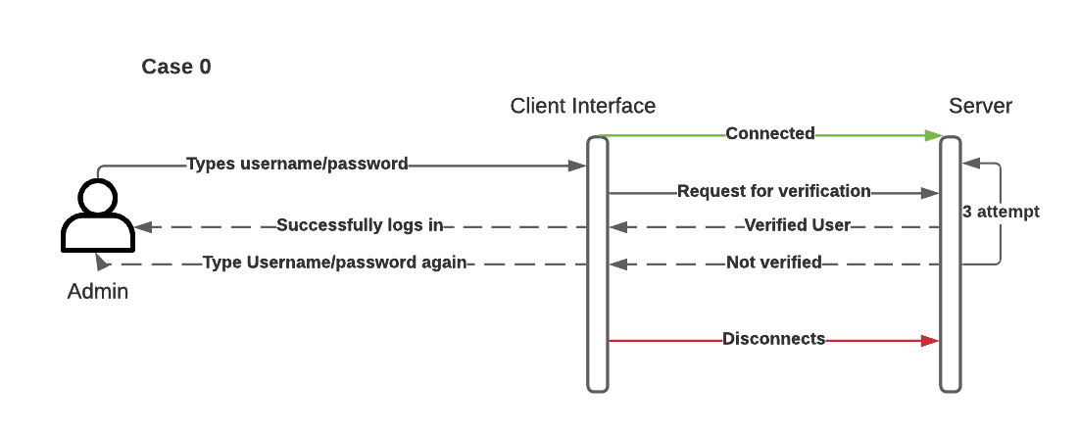
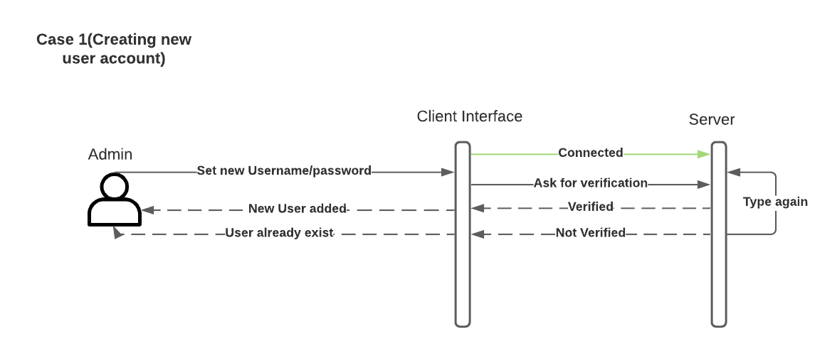
HIGH LEVEL DESIGN

Slide 5
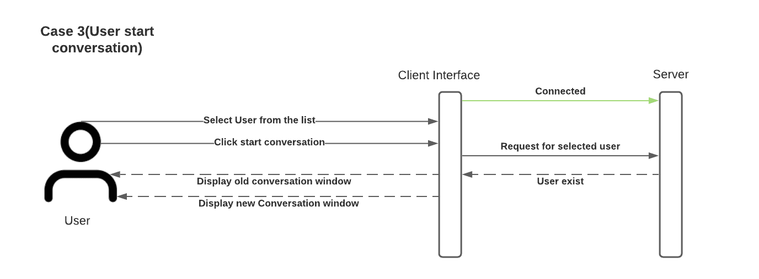
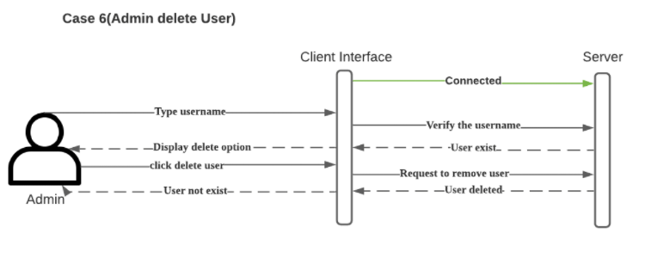
HIGH LEVEL DESIGN

Slide 6
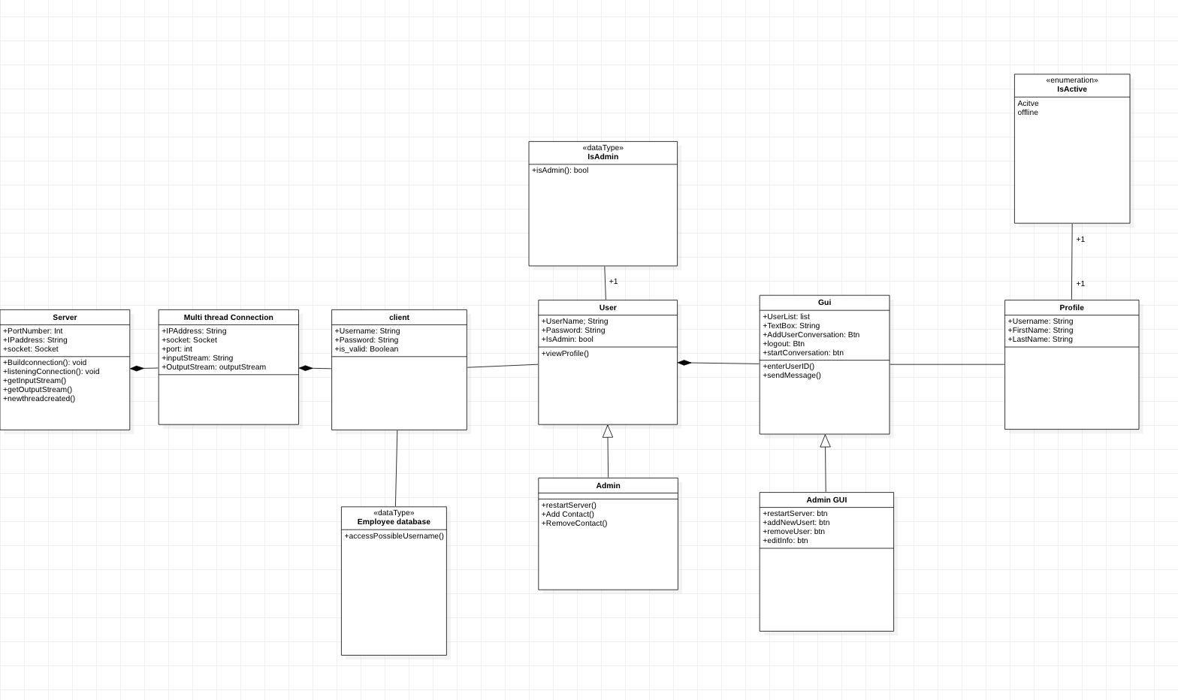
HIGH LEVEL DESIGN

Slide 7
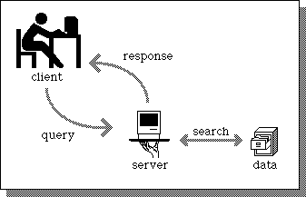
MESSAGE PASSING SOLUTION
Server Creates Thread
Passes Input / Output Stream
Individual & Group Messaging

Slide 8
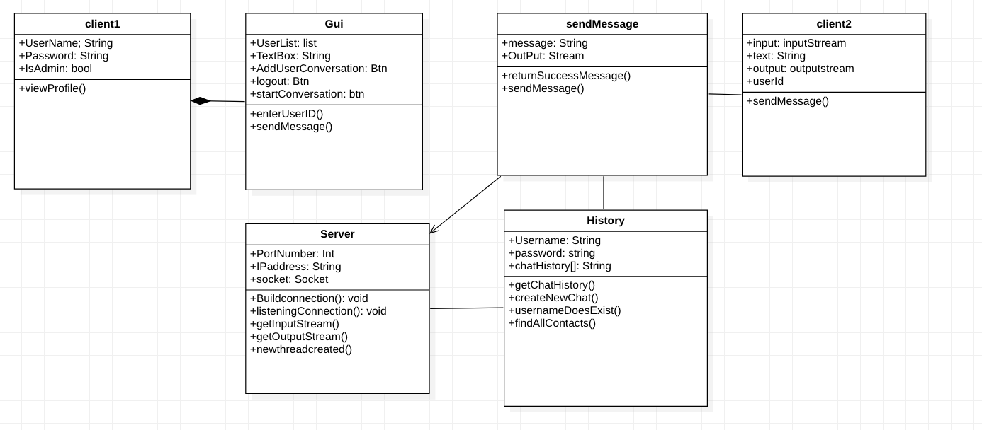
Sending a message to a Client

